Slide 1

Data Analytics Interim Project AdventureWorks
Presented by Group 5
Stephy Zhu
Aqsa Shuja
Iris Engler

Slide 2
Project Overview
Company Background
Approach
Adventure Works Cycles
Manufactures and sells bicycles to North American, European and Asian commercial markets
Over 200 employees
Data extracting
Exploratory Data Analysis
Data Visualisation
Notes:
EDA - To identify relationships to better understand the data.

Slide 3
Technologies and Tools
Data Source
Human Resources
Sales
Tools
SQL Server Management Studio
Python (Jupyter)
Import libraries in Python (Pandas, Matplotlib.pyplot, Seaborn)
Notes:
Adventure works is a large database containing over 20 tables and views, but for this project, we will use tables under two schemas to perform the analysis - Human Resources and Sales

Slide 4
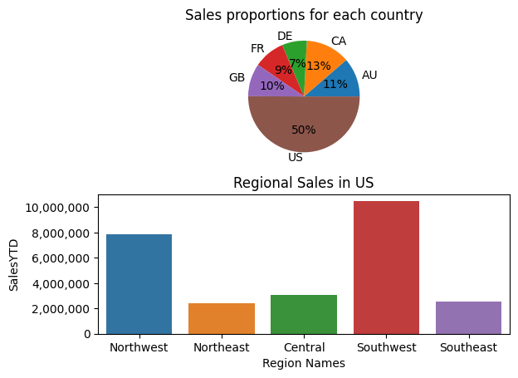
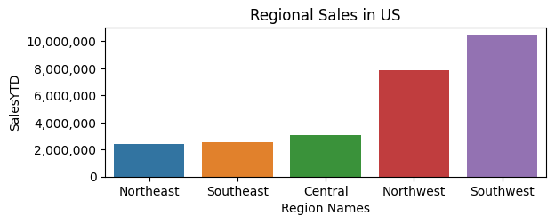
Regional Sales in the Best Performing Country

Slide 5
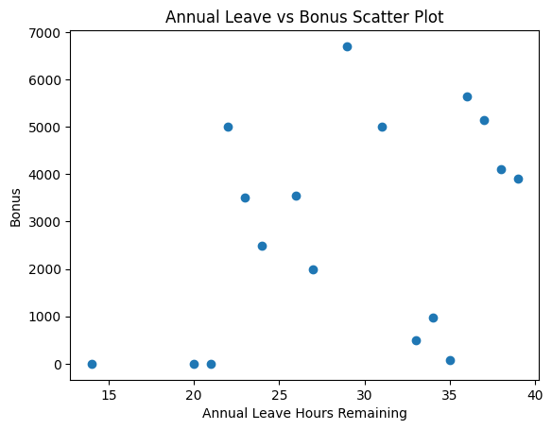
Relationship between Annual Leave & Bonus
Do people who earn a higher bonus take less annual leave?
Notes:
Do people get higher bonus if they take less annual leave? From the scatter plot we can see a slightly positive relationship between annual leave hours remaining and the bonus. It suggests while taking less Annual leave might results in higher bonus, the relationship between annual leave and bonus is not strong. There may be other factors that affect the bonus as well.

Slide 6
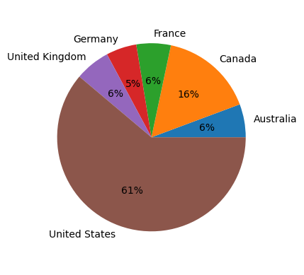
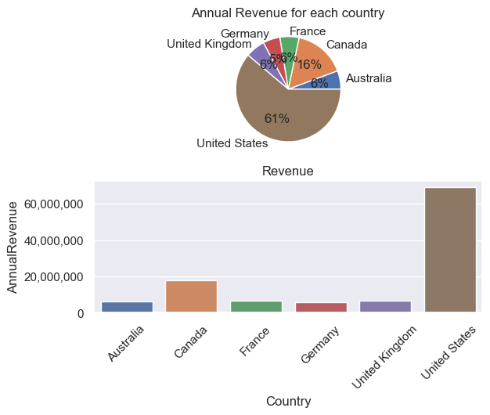
Relationship between Country and Revenue
Ronny Reader
REVENUE
Vinny Viewer
SALES

Slide 7
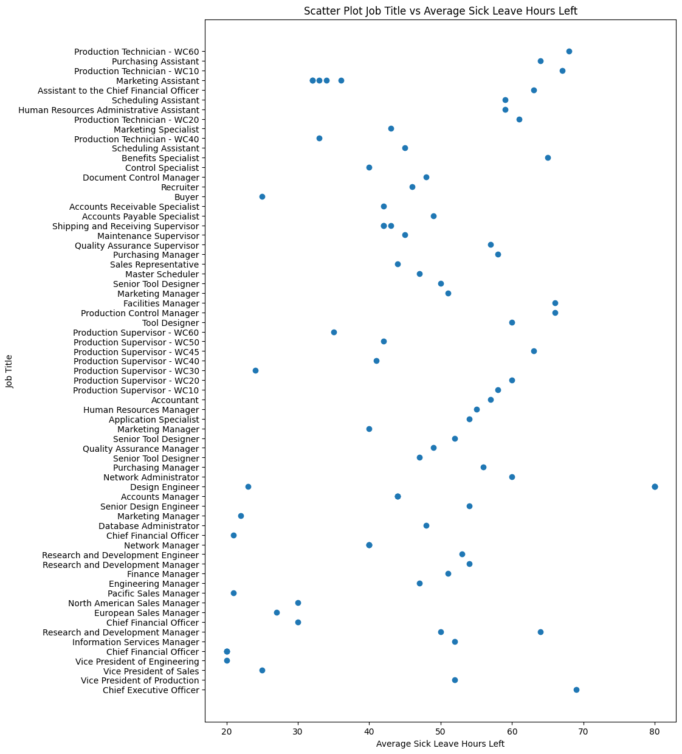
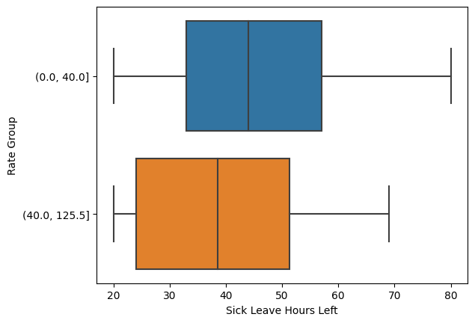
Relationship between Sick Leave and Job Title

Slide 8
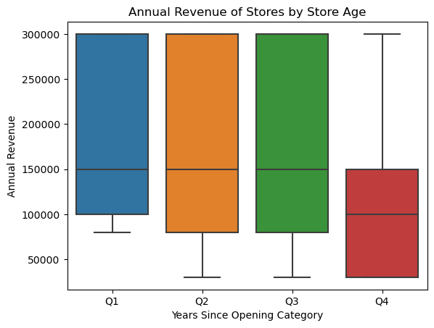
Relationship between Store Trading Duration and Revenue
The oldest stores (Q4) have significantly lower revenues than newer (Q1-Q3) stores.
Perry Presenter

Slide 9
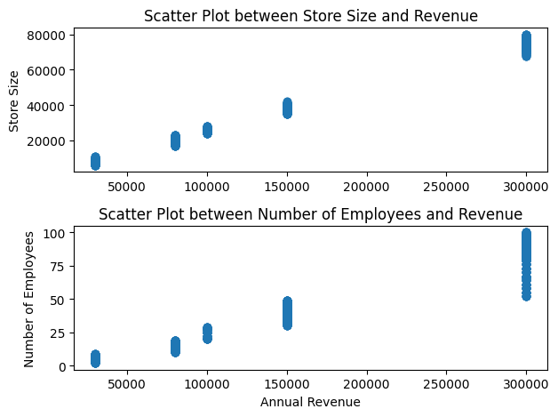
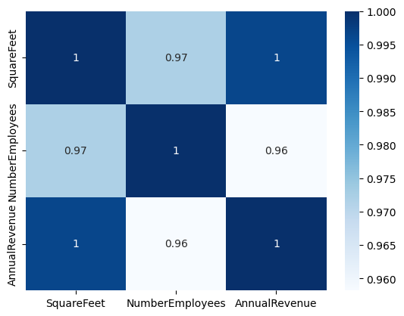
Relationship between Size of Stores, Number of Employees and Revenues
Notes:
Larger stores have more employees and more stock and will therefore generate more revenue.

Slide 10
Challenges Faced
Wendy Writer
Installing the SQL Server Management Studio (SSMS)
Understanding the data, for example the ‘Sick Leave’ field. We used the data dictionary description to solve problems.
Exploration of data to determine which fields to use
Ronny Reader
Abby Author
Perry Presenter
Vinny Viewer
Molly Maker
Casey Creator
Berry Books

Slide 11
Thank you

